Slide 1
Title Slide
Title: Online Electronics Showroom
Subtitle: ASP.NET Web Application
Created By: [Your Name]
Technologies Used:
Frontend: HTML, CSS, JavaScript, Bootstrap
Backend: ASP.NET (C#), .NET Framework 4.8
Database: SQL Server (MDF file in Visual Studio)
Tools: Visual Studio, Local database using Visual Studio

Slide 2
Project Objective
Develop an online electronics showroom for users to browse, filter, and purchase products.
Implement user authentication and admin management functionalities.
Enable admins to manage products, orders, and users dynamically.
Ensure a seamless shopping experience with cart and checkout workflows.

Slide 3
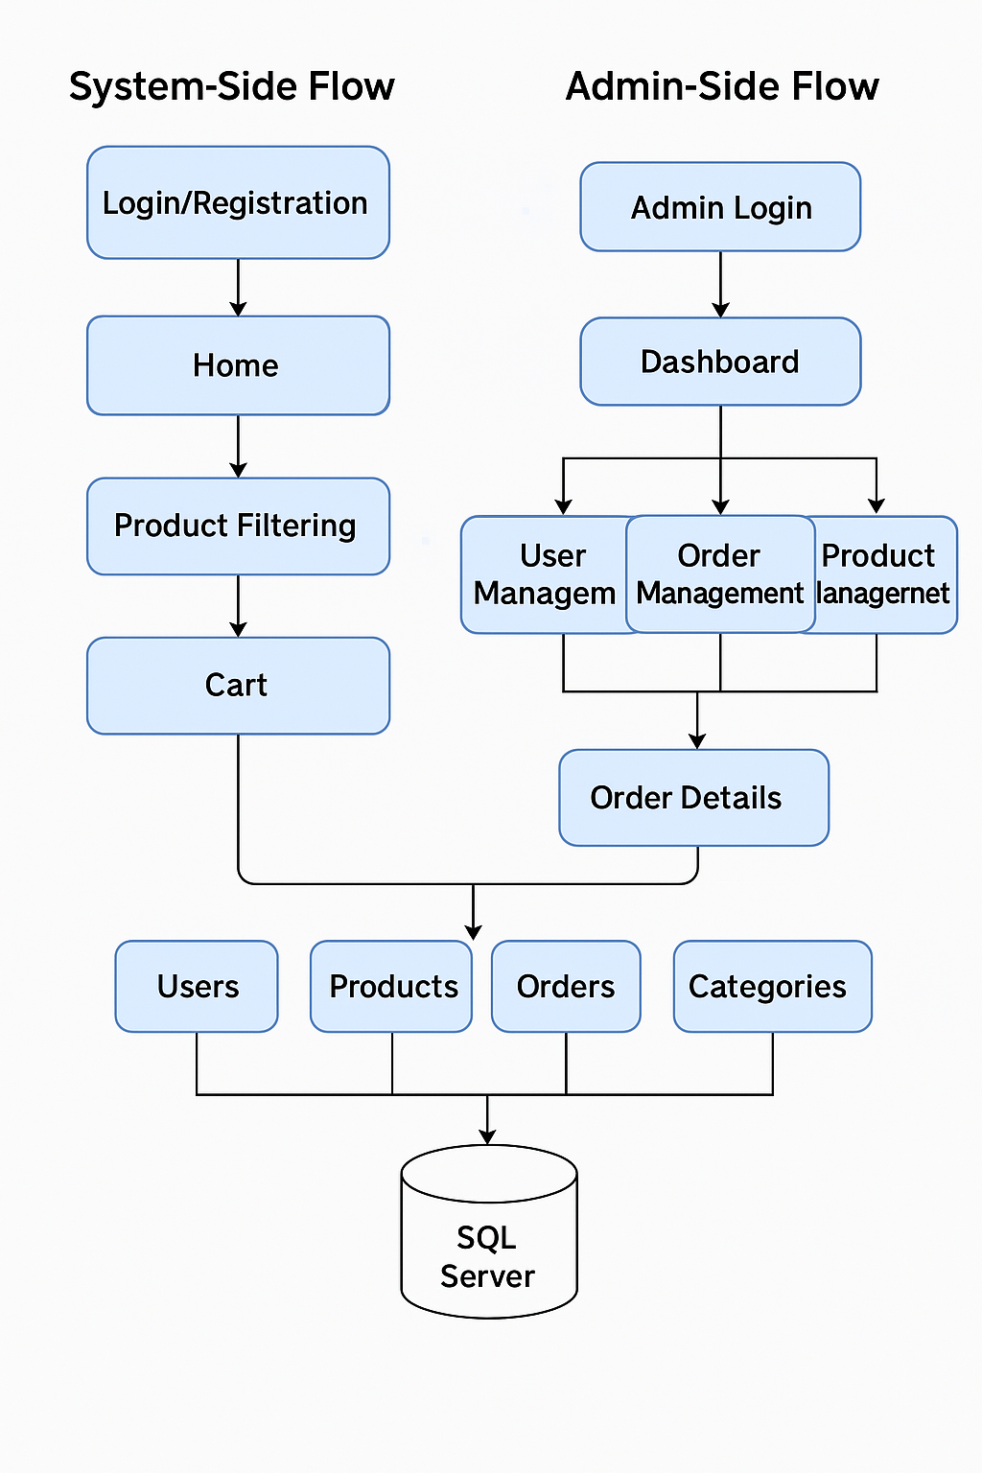
System Architecture Diagram

Slide 4
User Authentication
Login Page:
Validates user credentials against the database.
Redirects to Home Page after successful login.
Features: Password hashing, session management.
Registration Page:
Collects user details (name, email, password).
Server-side validation for duplicate emails/username.

Slide 5
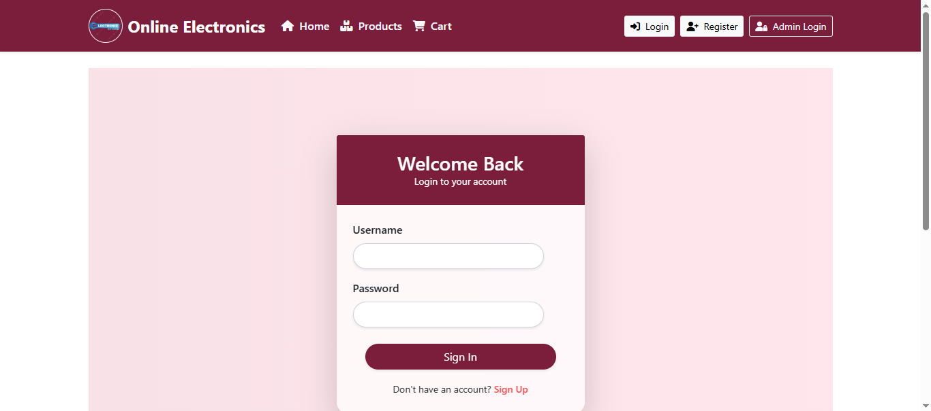
Login Page ScreenShot

Slide 6
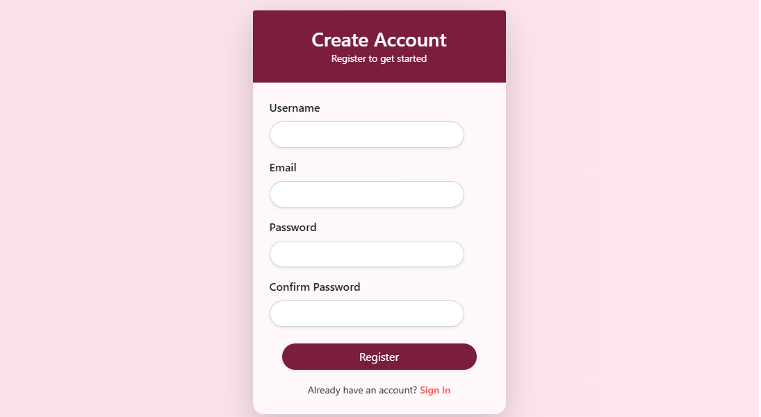
Registration Page ScreenShot

Slide 7
Home Page
Banner Image: Displays promotions/new arrivals.
Explore Popular Categories: Displays the latest and Popular Categories (e.g., smartphones, laptops).
Recent Offers: Grid/carousel layout for discounted products.
Footer: Contact info, quick links.

Slide 8
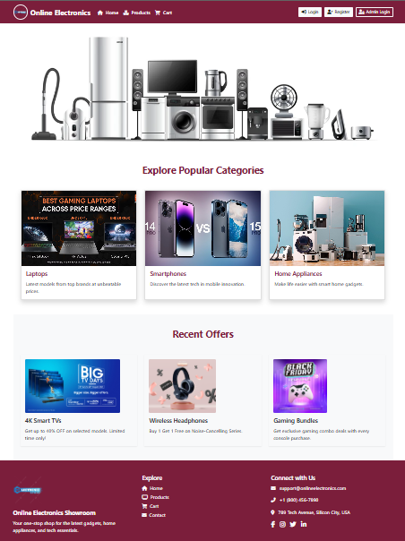
Home Page ScreenShot

Slide 9
Product Filtering & Cart
Product Filtering:
Dropdown menu to filter products by category.
Products displayed in a grid with images, prices, and "Add to Cart" buttons.
Cart Page:
Lists selected products with quantities and total price.
Options to remove items or proceed to checkout.

Slide 10
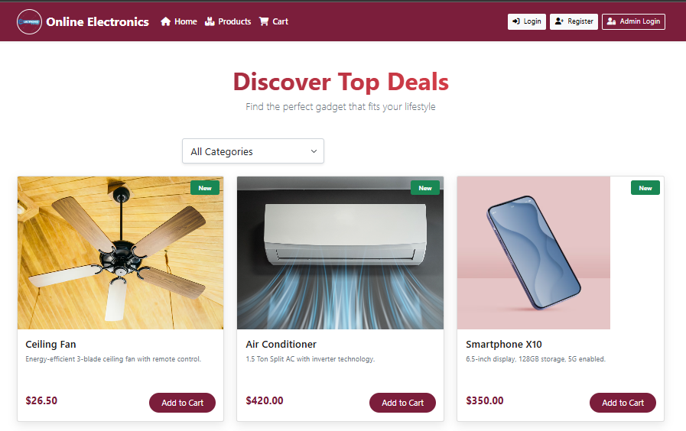
Product Page ScreenShot

Slide 11
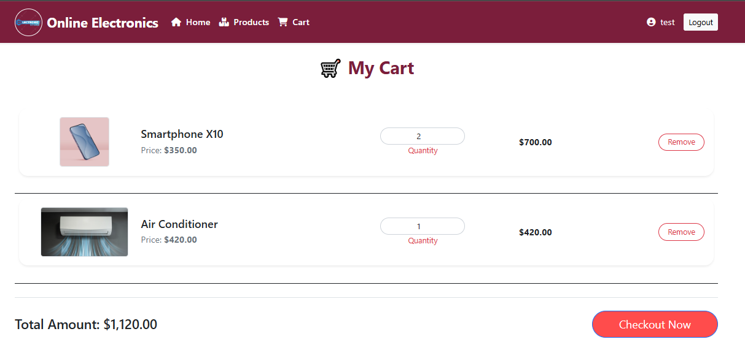
Cart page Screenshot

Slide 12
Checkout Page
Collects shipping details (address, contact).
Validates input fields (e.g., email format, required fields).
Order Placement: Saves order to database and clears the cart.

Slide 13
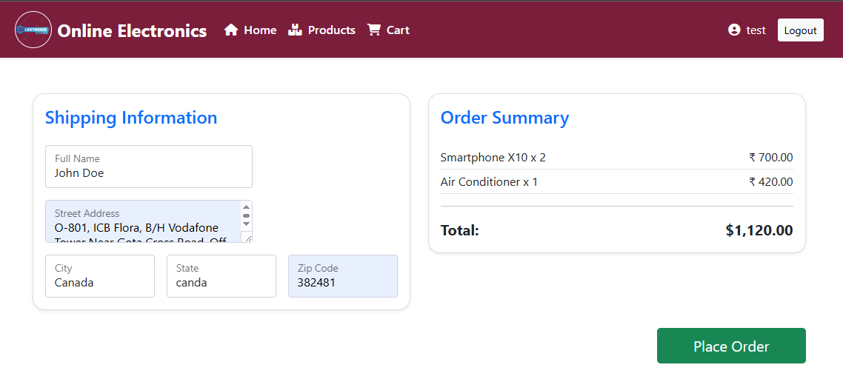
Checkout Page Screenshot

Slide 14
Admin Login & Dashboard Page
Admin Login:
Separate login page with admin credentials.
Redirects to Admin Dashboard after authentication.
Admin Dashboard:
Product Management: Add/Edit/Delete products (name, price, category, image).
Order Management: View orders, update status (e.g., shipped, delivered).
User Management: Block users or create new admin accounts.

Slide 15
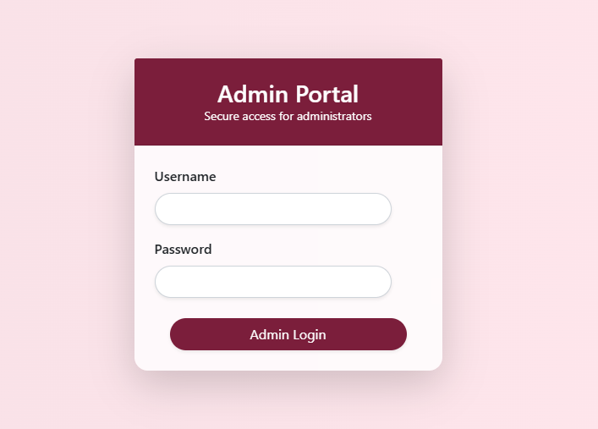
Admin Login Page Screenshot

Slide 16
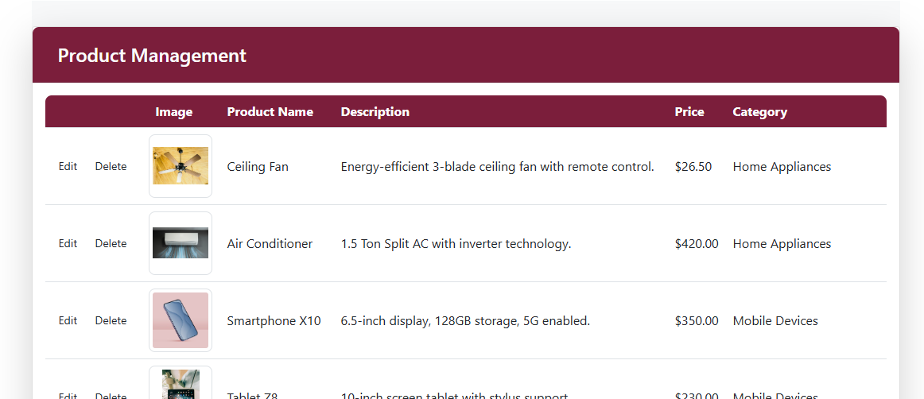
Admin Dashboard Page Screenshot

Slide 17
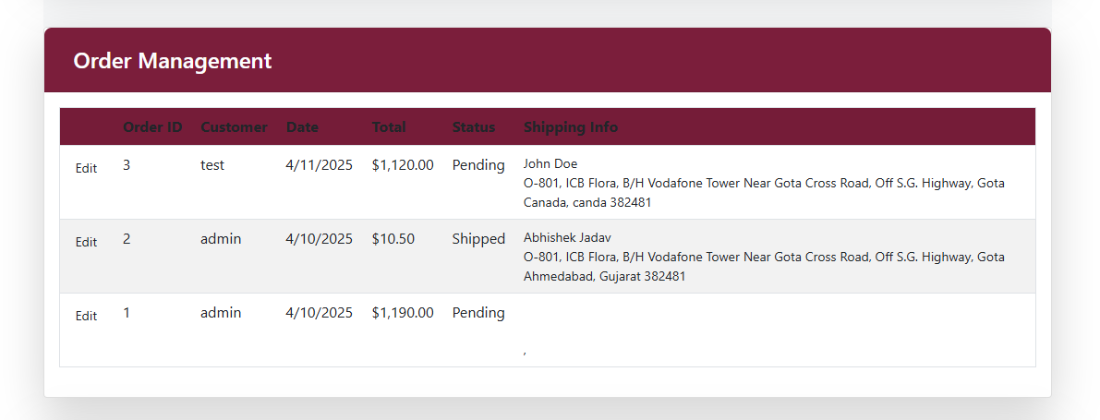
Admin Order Management

Slide 18
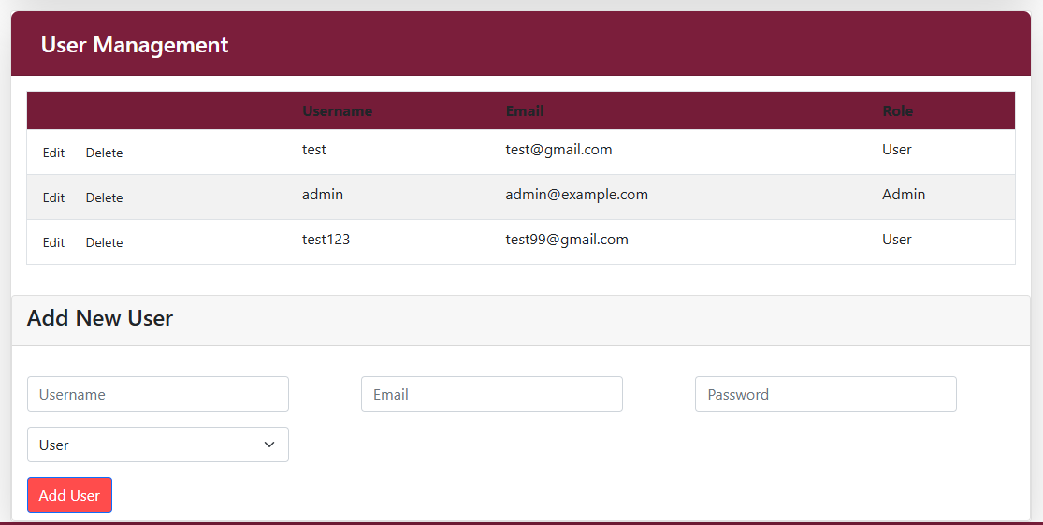
Admin User Management

Slide 19
Key Features
User-Friendly UI: Responsive design with Bootstrap.
Role-Based Access: Separate workflows for users and admins.
Dynamic Filtering: Real-time product filtering by category.
Security: Password hashing, admin privileges restricted.

Slide 20
Future Enhancements
Integrate payment gateways (Razorpay, PayPal).
Add product search and review/rating system.
Implement email notifications for order updates.

Slide 21
Conclusion
Successfully built a functional e-commerce platform with ASP.NET.
Demonstrated skills in full-stack development, database design, and user/admin workflows.

